Slide 1
Unit 1
What’s your address?
Lesson 2
Teacher: Ms. Thom

Slide 2
VOCABULARY

Slide 3
Vocabulary
Big
/big/
Small
/smɔːl/
(a) nhỏ

Slide 4
Vocabulary
Noisy
/ˈnɔɪzi/
(a) Ồn ào
quiet
/ˈkwaɪət/
(a) Yên tĩnh

Slide 5
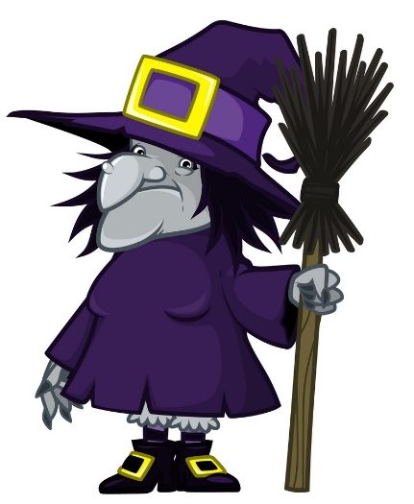
Vocabulary
beautiful
/ˈbjuːtɪfl/
(a) đẹp, xinh

Slide 6
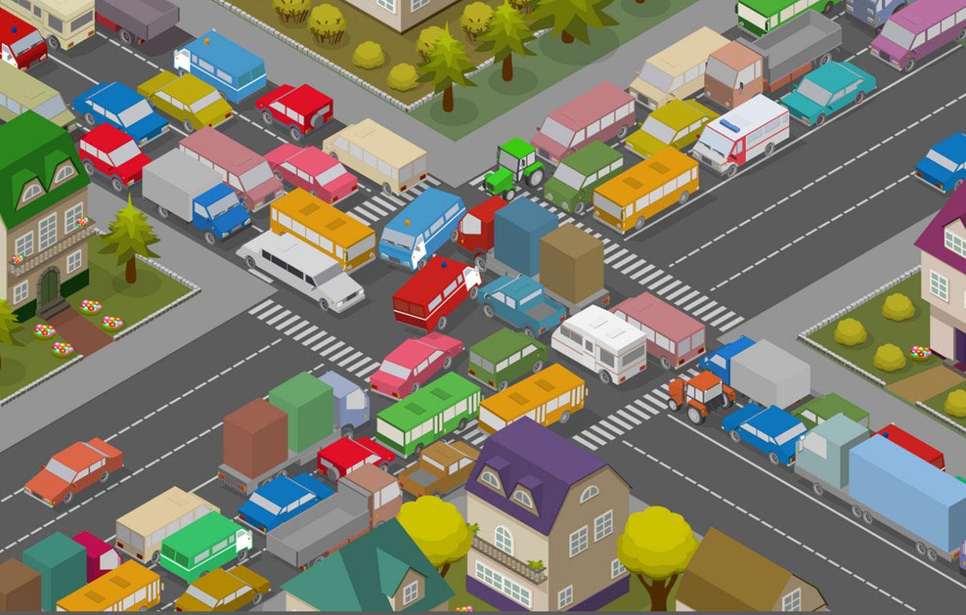
Vocabulary
crowded
/ˈkraʊdɪd/
(a) Đông đúc

Slide 7
Vocabulary
busy
/ˈbɪzi/
(a) bận rộn

Slide 8
Vocabulary
large
/lɑːrdʒ/
(a) rộng

Slide 9
Vocabulary
far
/fɑː/
(a) xa

Slide 10
Vocabulary
hometown
/ˈhəʊmtaʊn/
(n) quê

Slide 11
Vocabulary
mountain
/ˈmaʊntən/
(n) núi

Slide 12
Vocabulary
island
ˈaɪlənd/
(n) Hòn đảo

Slide 13
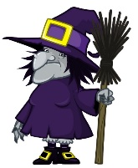
Vocabulary
island
mountain
hometown
far
noisy
big
large
quiet
small
beautiful
crowded

Slide 14
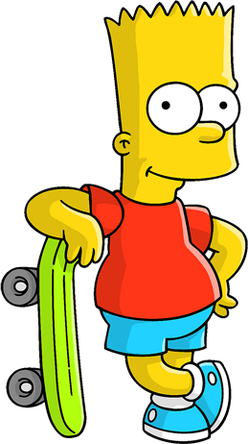
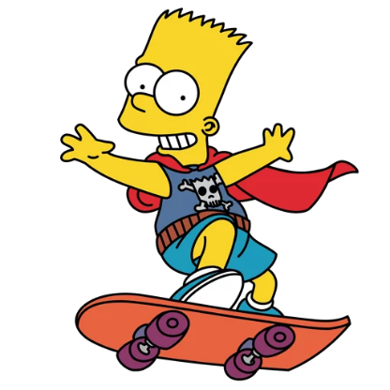
WHERE IS
BART
?

Slide 15
TIME’S UP
NEXT
A
I live on an village.
B
I live on an Island.
C
I live on an mountain.

Slide 16
TIME’S UP
NEXT
A
Hai Phong is my mountain.
B
Hai Phong is my island.
C
Hai Phong is my hometown.

Slide 17
TIME’S UP
NEXT
A
Near
B
Far
C
Small

Slide 18
TIME’S UP
NEXT
A
moutain
B
city
C
village

Slide 19
TIME’S UP
NEXT
A
Crowded
B
Beautiful
C
Quiet

Slide 20
TIME’S UP
NEXT
A
Large
B
Small
C
Noisy

Slide 21
TIME’S UP
NEXT
A
Noisy
B
Busy
C
Quiet

Slide 22
TIME’S UP
NEXT
A
Noisy
B
Small
C
Big

Slide 23
TIME’S UP
NEXT
A
Crowded
B
Quiet
C
Moutain

Slide 24
TIME’S UP
NEXT
A
Big
B
Small
C
Noisy

Slide 25
Welldone!
END

Slide 26
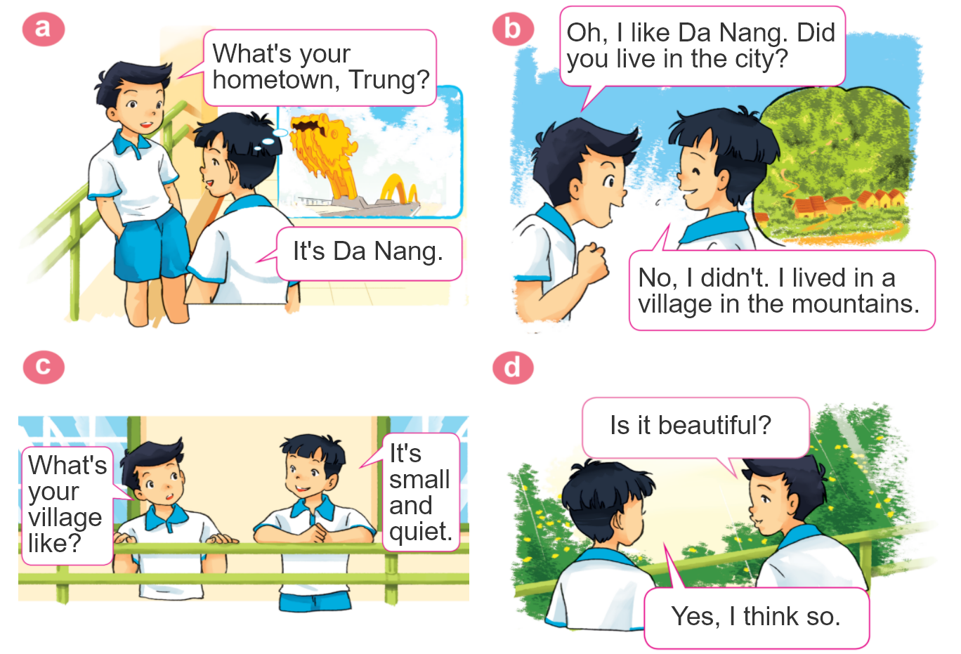
1. Look, listen and repeat.

Slide 27
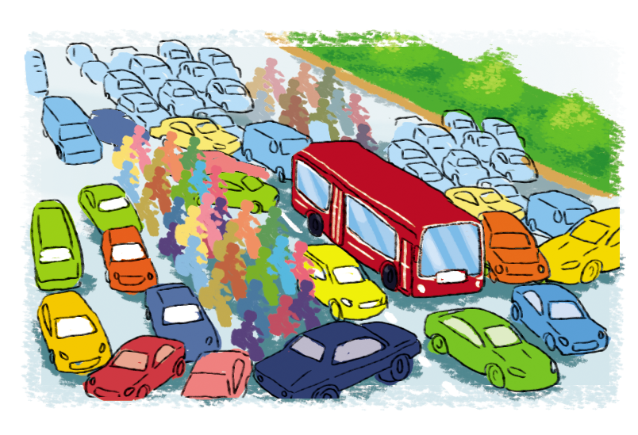
2. Point and say
city,
big and busy
What's the ________ like?
city
It's __________________.
big and busy

Slide 28
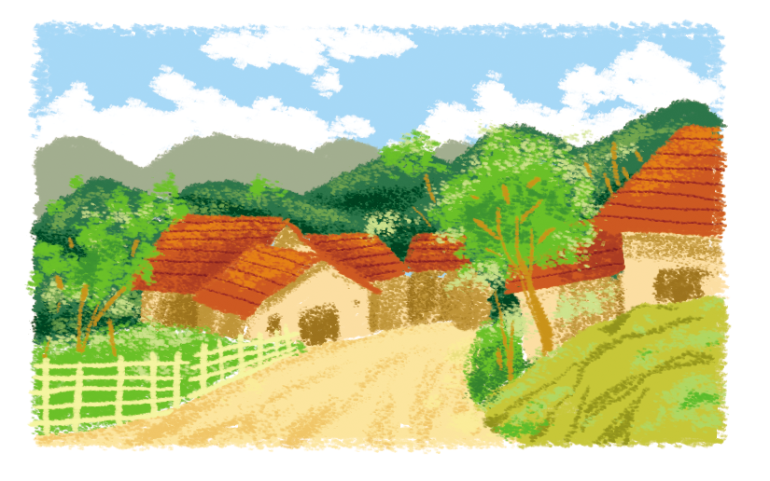
2. Point and say
village,
far and quiet
What's the ________ like?
village
It's __________________.
far and quiet

Slide 29
I. New words: - big and busy: to lớn và ồn ào - far and quiet: xa và yên bình - large and crowded: rộng lớn và náo nhiệt small and pretty: nhỏ và xinh đẹp
II. Structure:
Hỏi và trả lời về quê hương bạn như thế nào?
What’s your villgage like?
It’s small and quiet.

Slide 30
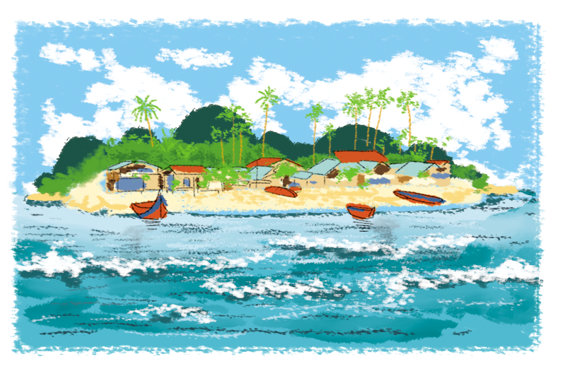
2. Point and say
island,
small and pretty
What's the ________ like?
island
It's __________________.
small and pretty

Slide 31
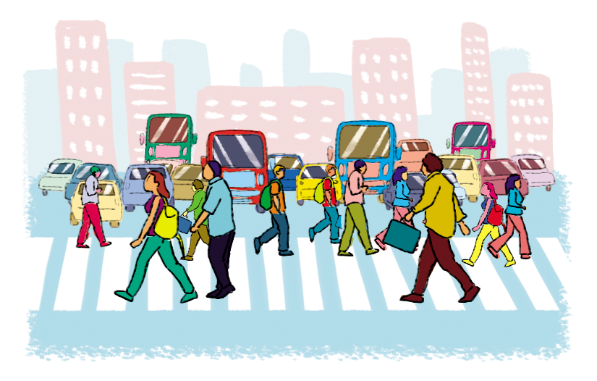
2. Point and say
town,
large and crowded
What's the ________ like?
town
It's __________________.
large and crowded

Slide 32
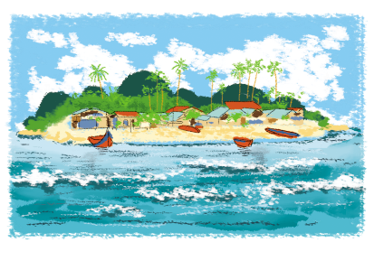
2. Point and say
What's the ________ like?
It's ___________.
city,
big and busy
town,
large and crowded
village,
far and quiet
island,
small and pretty

Slide 33
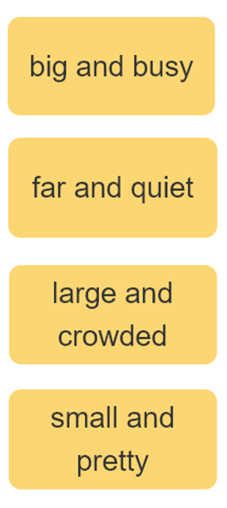
3. Let’s talk
I live ____________.
Where do you live?
What's it like?
It’s ______.
Who do you live with?
I live with ________.
parents
grandparents

Slide 34
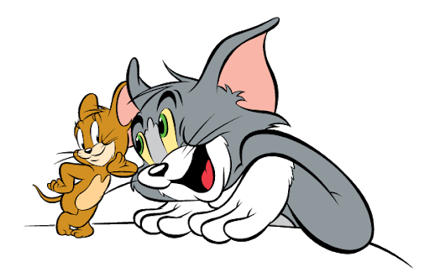
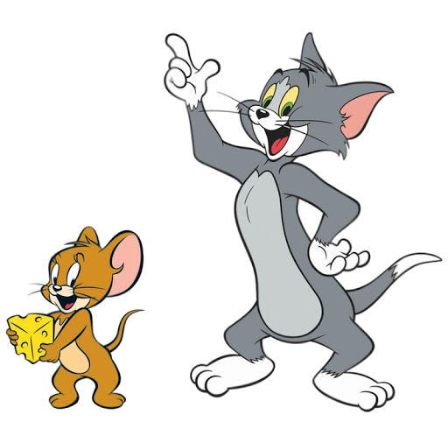
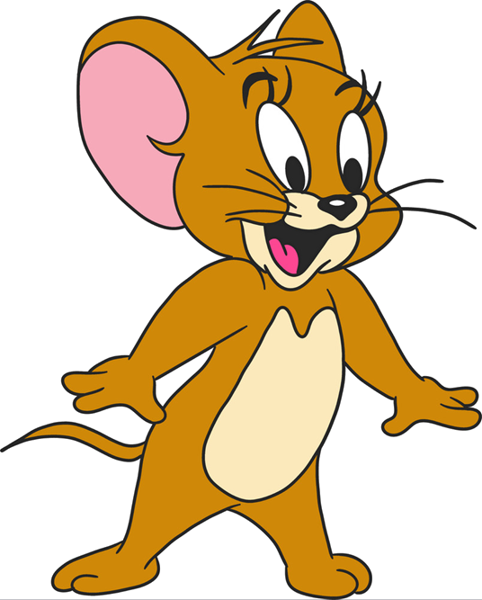
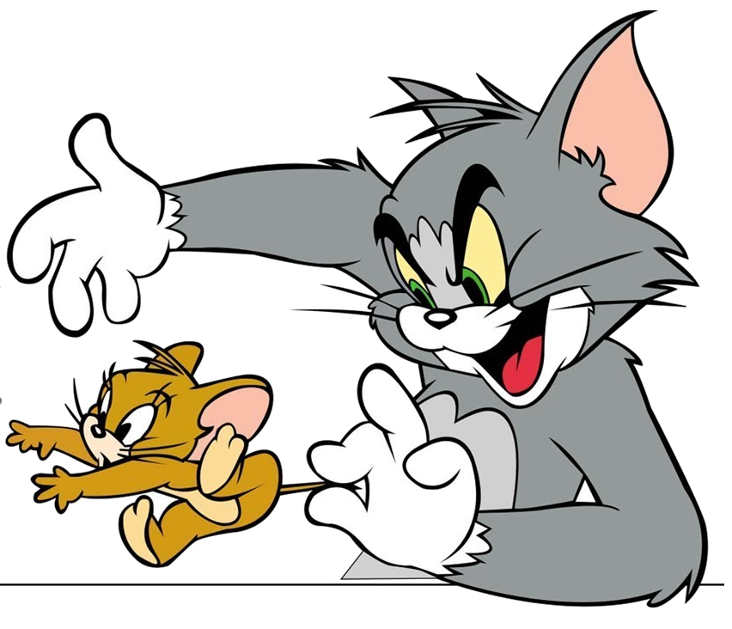
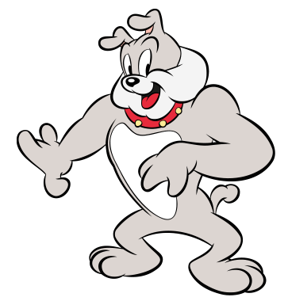
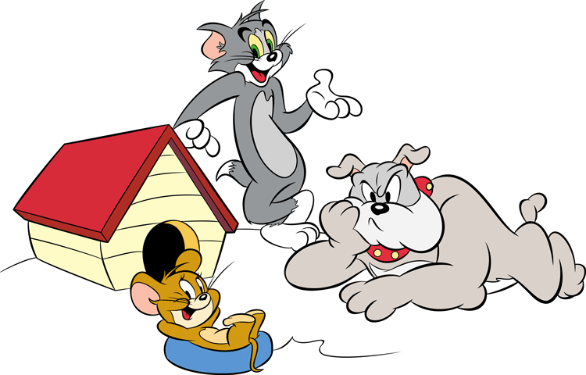
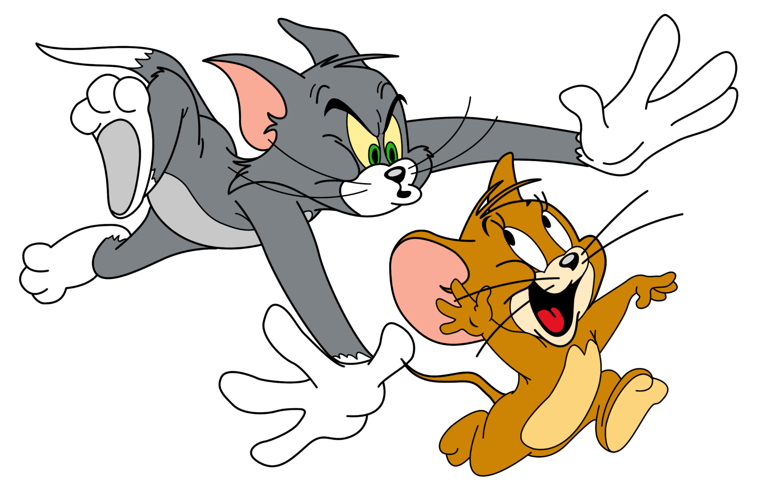
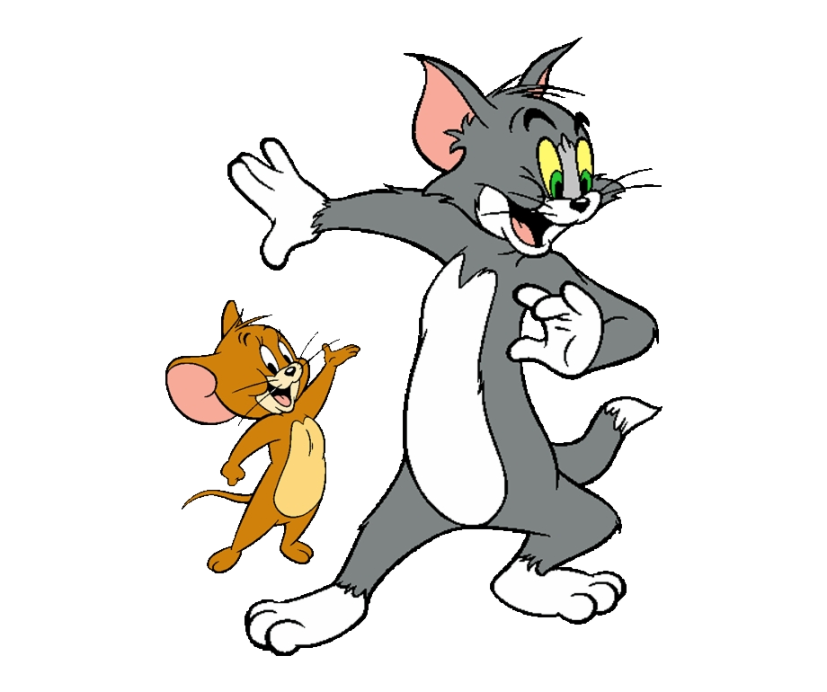
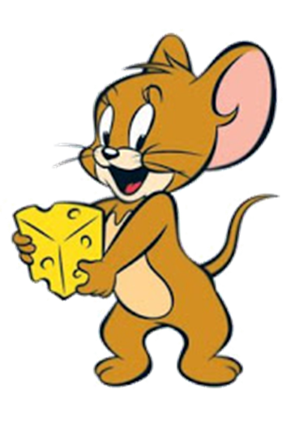
GAME
Notes:
Ms Huyền Phạm - 0936.082.789 – YOUTUBE: MsPham. Facebook: Dạy và học cùng công nghệ.

Slide 35
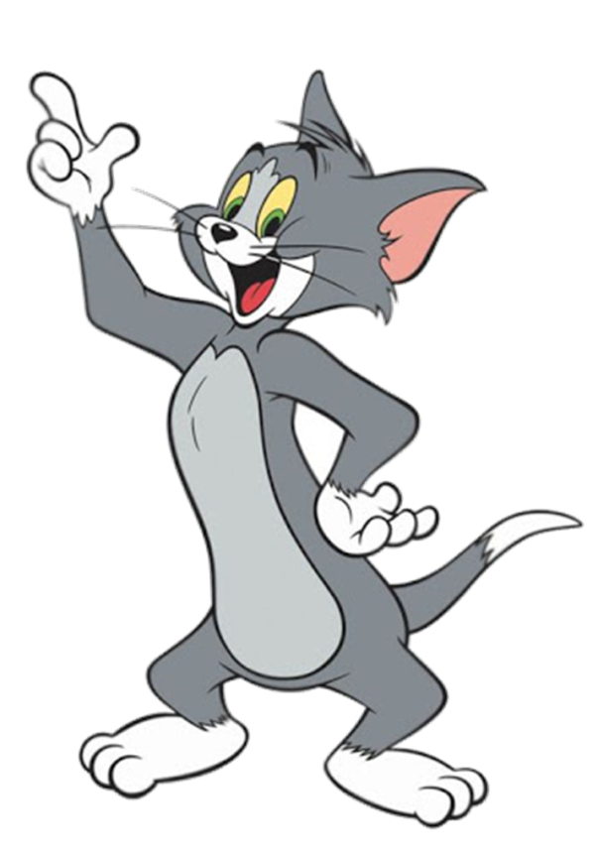
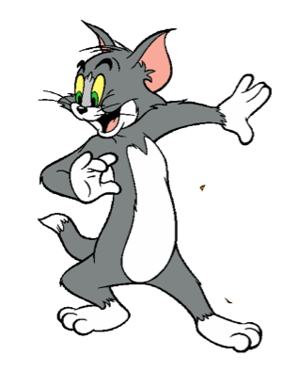
Where do you live?
I live in Quang Ninh.
I live ____________.
What's it like?
It’s ______.
Who do you live with?
I live with ________.
Notes:
Ms Huyền Phạm - 0936.082.789 – YOUTUBE: MsPham. Facebook: Dạy và học cùng công nghệ.

Slide 36
Mai: (1) your address?
Trung: (2) 81, Tran Hung Dao Street.
Mai: (3) do you live with?
Trung: My grandparents.
Mai: Do you (4) living in Ha Noi?
Trung: Yes, very much.
Mai: (5) your hometown like?
Trung: It's small and quiet.
What’s your hometown like? It’s large and far.
I live ____________.
It’s ______.
I live with ________.
Notes:
Ms Huyền Phạm - 0936.082.789 – YOUTUBE: MsPham. Facebook: Dạy và học cùng công nghệ.

Slide 37
What’s your flat like?
It’s beautiful.
Notes:
Ms Huyền Phạm - 0936.082.789 – YOUTUBE: MsPham. Facebook: Dạy và học cùng công nghệ.

Slide 38
Check
Who do you live with?
I live in a village.
Where do you live?
Notes:
Ms Huyền Phạm - 0936.082.789 – YOUTUBE: MsPham. Facebook: Dạy và học cùng công nghệ.

Slide 39
Check
Where’s your address? It’s 81, Orange street.
What’s
Notes:
Ms Huyền Phạm - 0936.082.789 – YOUTUBE: MsPham. Facebook: Dạy và học cùng công nghệ.

Slide 40
Check
How’s the village like? It’s small and quiet.
What’s
Notes:
Ms Huyền Phạm - 0936.082.789 – YOUTUBE: MsPham. Facebook: Dạy và học cùng công nghệ.

Slide 41
Mai: Who do you live with?
Trung: My grandparents
Notes:
Ms Huyền Phạm - 0936.082.789 – YOUTUBE: MsPham. Facebook: Dạy và học cùng công nghệ.

Slide 42
What’s the like?
It’s small and pretty.
Notes:
Ms Huyền Phạm - 0936.082.789 – YOUTUBE: MsPham. Facebook: Dạy và học cùng công nghệ.

Slide 43
Where do you live?
It’s in Quang Ninh.
Check
I live
Notes:
Ms Huyền Phạm - 0936.082.789 – YOUTUBE: MsPham. Facebook: Dạy và học cùng công nghệ.

Slide 44
Good job!
Notes:
Ms Huyền Phạm - 0936.082.789 – YOUTUBE: MsPham. Facebook: Dạy và học cùng công nghệ.

Slide 45
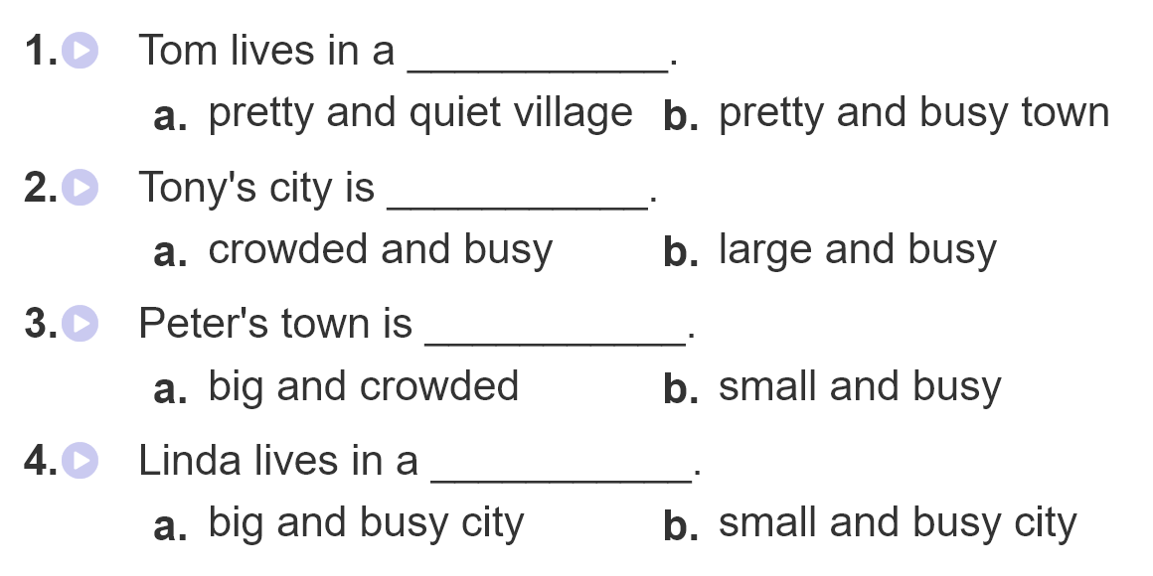
4. Listen and circle

Slide 46
5. Write about you.

Slide 47
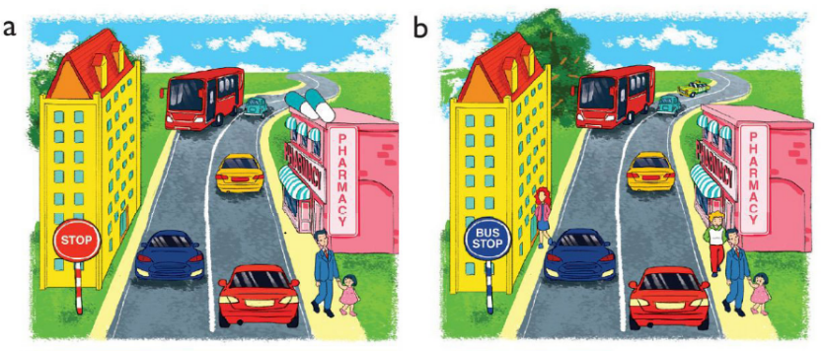
6. Let’s play
Spot the difference
(Click the different spot)

Slide 48
THANK YOU!
Welcome to join with me!
MsPham Powerpoint
Mspham

Slide 49
Unit 1: What’s your address?
Lesson 2 (1,2,3)
New words:
- big and busy (adj): to lớn và náo nhiệt
- far and quiet (adj): xa và yên tĩnh
- large and crowded (adj): rộng lớn và đông đúc
- small and pretty (adj): nhỏ và xinh đẹp
- hometown (n): quê / quê hương
II. Structures:
Hỏi về quê hương của bạn như thế nào:
What’s your village like ? (Làng của bạn trông như thế nào?)
hometown like ?
city
Ha Noi

